Slide 1
THE THEORY OF AMR
TRAINING PRESENTATION

Slide 2
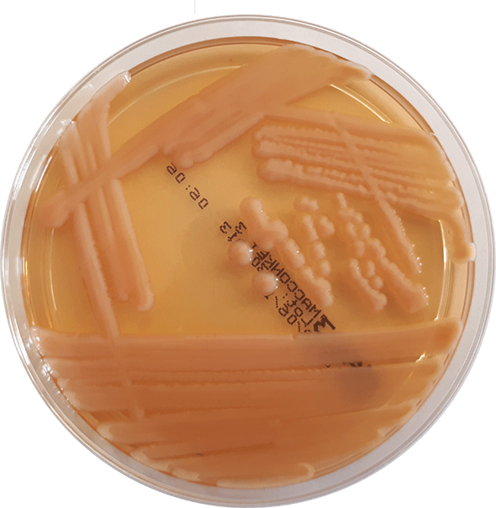
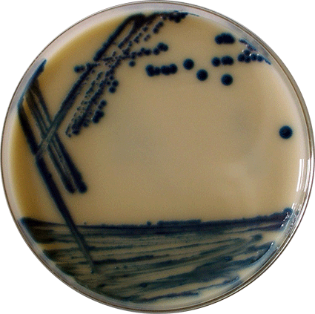
Enterobacteriales order
(formerly Enterobacteriaceae family)
Species of the order: E. coli, Klebsiella (Raoultella), Enterobacter, Proteus, Citrobacter, Hafnia, etc.
This order is a normal part of the gut microbiota in the lower part of the gastrointestinal tract.
They may cause health problems, if they gain access to areas of the body that are normally sterile.
Gram-negative bacteria on selective medium 1
Gram-negative bacteria on selective medium 2

Slide 3
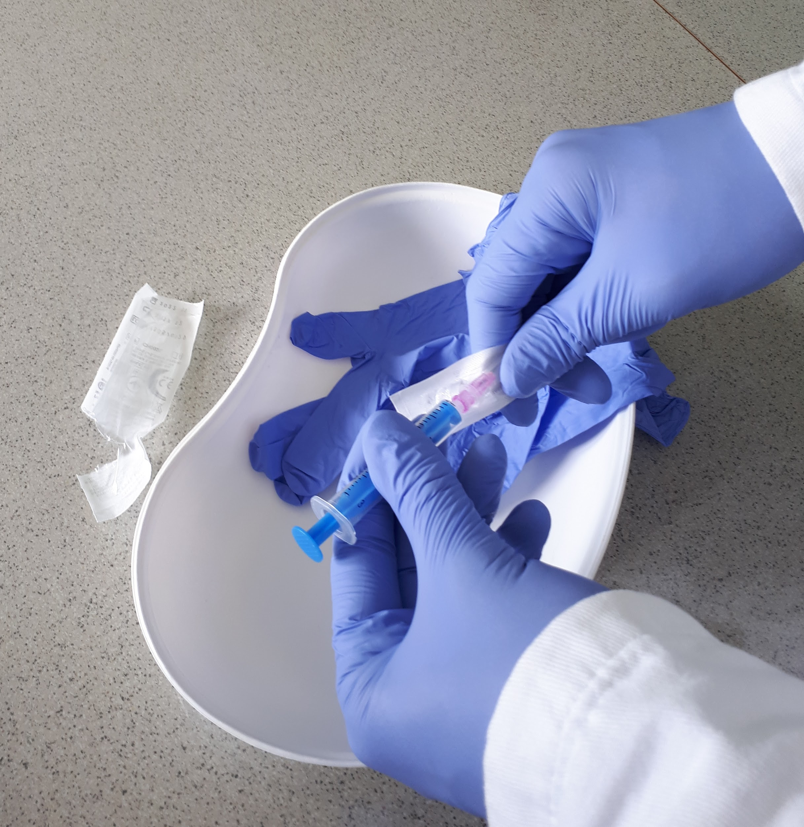
Spreading of Enterobacteriales in clinical settings
In case of inadequate hygiene, bacteria may spread from person to person through contact with colonized people and contaminated devices.
Bacteria may cause hospital-acquired infections: pneumonia, bloodstream infection, urogenital infection, skin and soft tissue infection, etc.

Slide 4
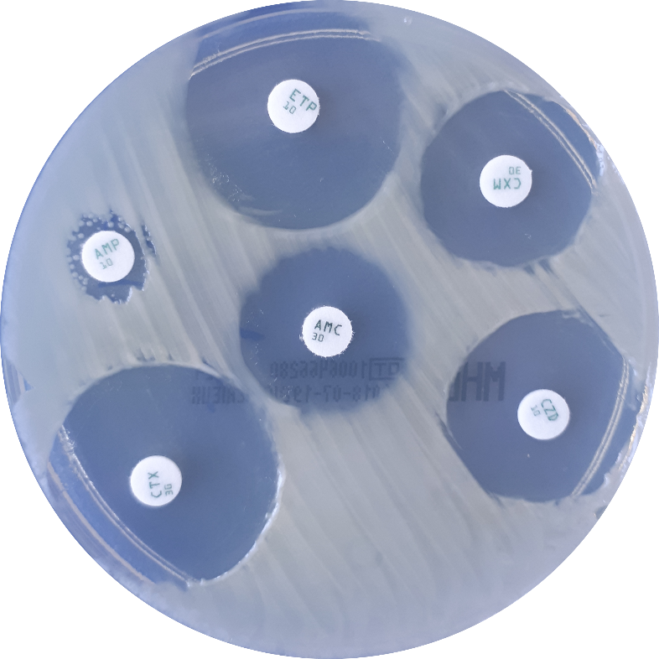
Antimicrobial resistance - A
The bacterium that causes an infection can be resistant to some types of antibiotics.
Bacteria change when exposed to antibiotics: using antibiotics may exert on bacteria a selective pressure leading to an increase in the prevalence of resistance.
Klebsiella:
naturally resistant to ampicillin

Slide 5
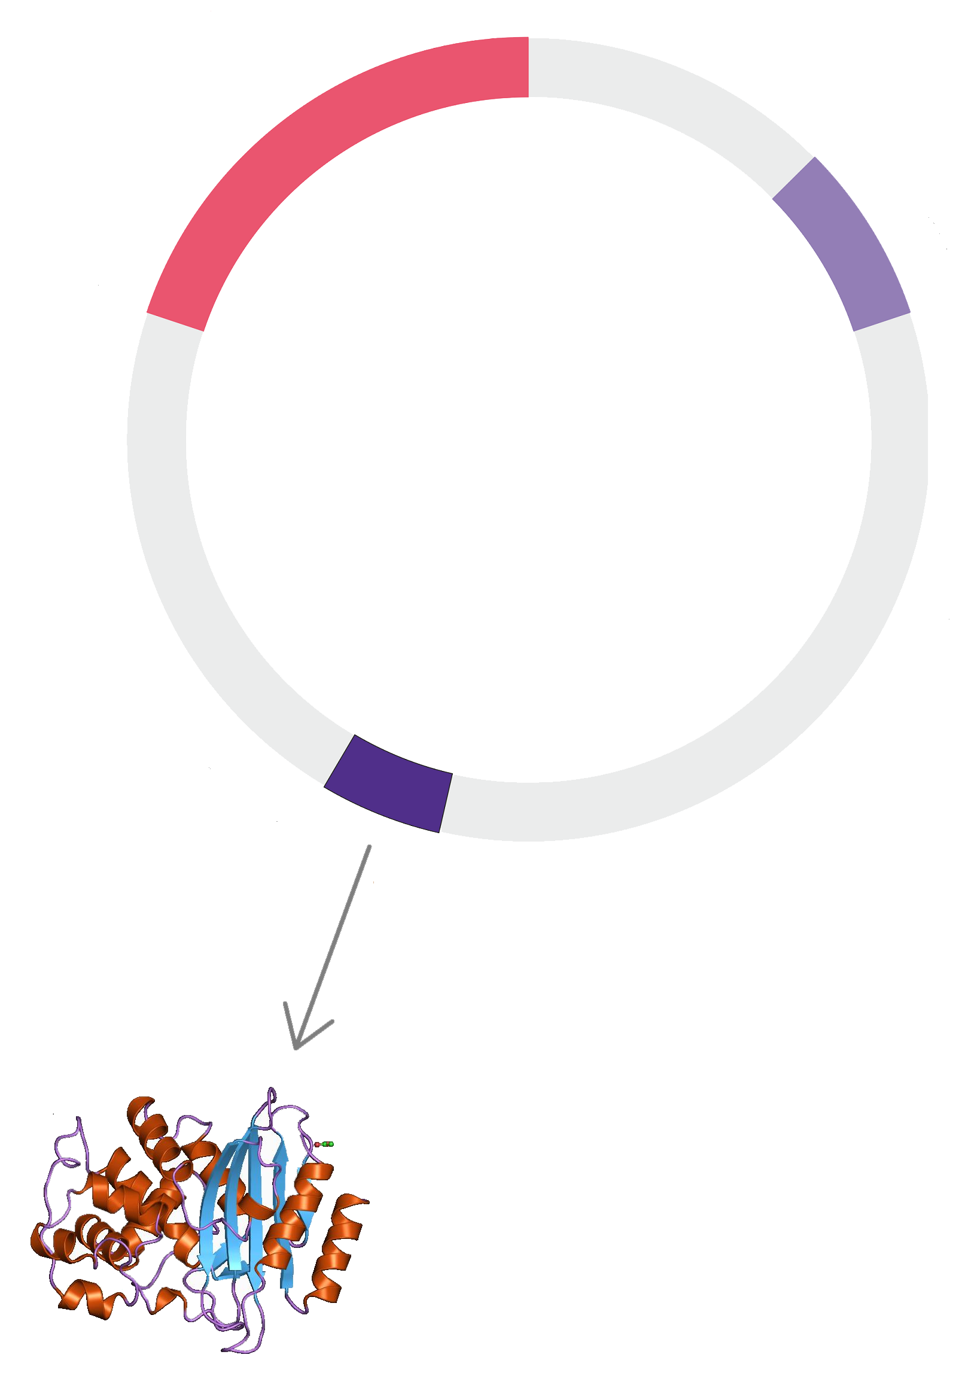
Antimicrobial resistance - B
Bacteria may become resistant through genetic mutation and acquiring resistance from other bacteria.
Resistance genes are commonly found on plasmids or other mobile genetic elements (e.g. transposons)
Plasmids can carry diverse resistance genes.
beta-lactamase - encoding gene
gene expression
beta-lactamase
Source of protein image:
https://www.ebi.ac.uk/

Slide 6
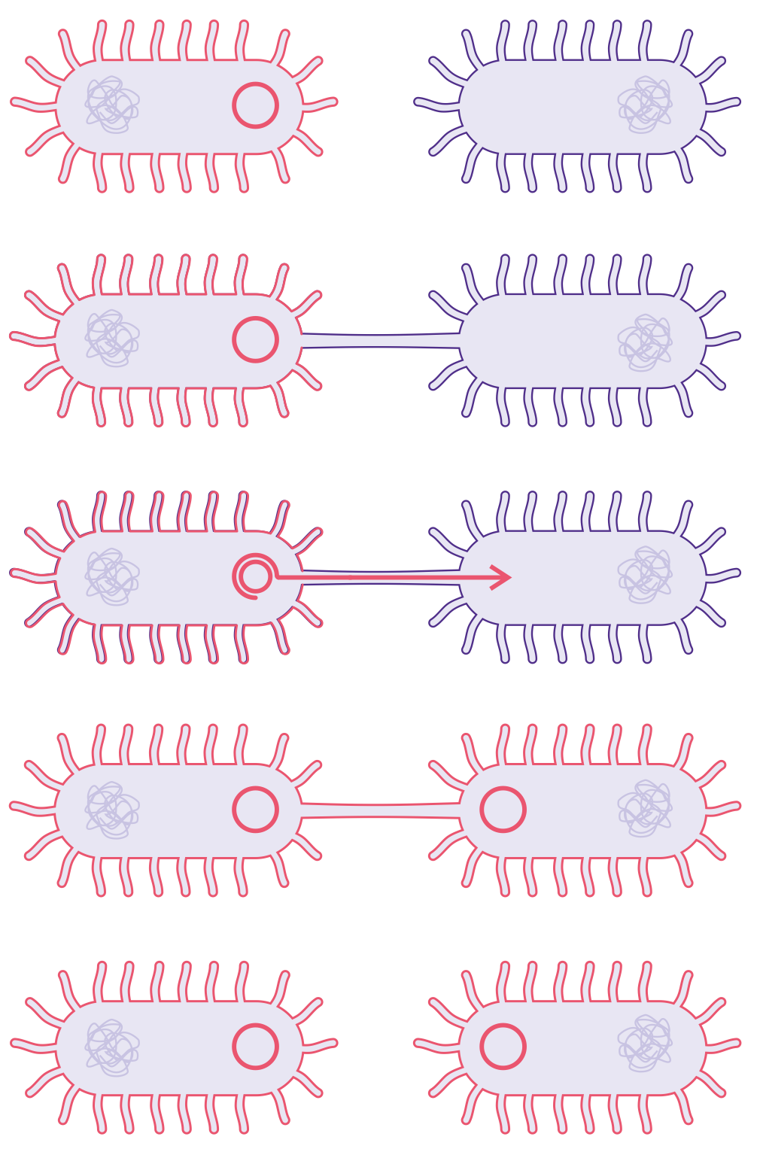
Antimicrobial resistance - C
Antibiotic resistant
Antibiotic sensitive
The horizontal spread of genes is possible between the same and different species of Enterobacteriaceae.
During conjugation, the donor cell provides the plasmid to the recipient.
If the plasmid carries a resistant gene, recipient cell become resistant as well.
Antibiotic resistant
The conjugative transfer of plasmid

Slide 7
Antimicrobial resistance - D
Mechanisms of bacterial resistance to antibiotics
Change(s) in the antibiotic protein target
Decrease of the membrane permeability
Efflux – the bacteria pump the antibiotics out
Antibiotic degradation: beta-lactamase production – the most common

Slide 8
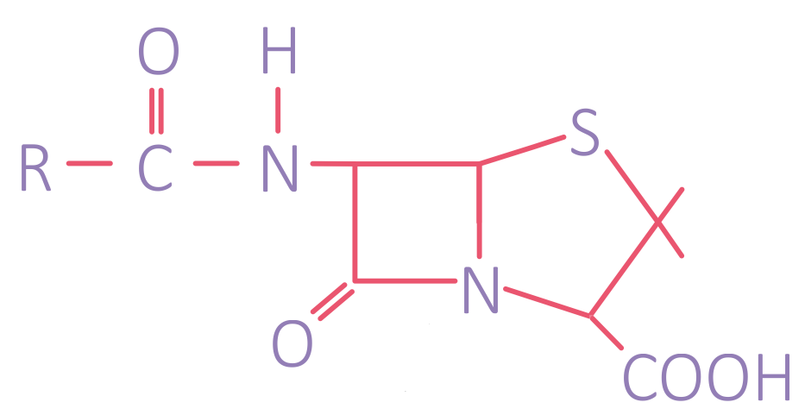
Beta-lactam antibiotics
can be used to treat infections caused by Enterobacteriaceae (and other bacteria)
inhibit the bacterial cell wall synthesis
have a four membered, nitrogen containing lactam ring
types: penicillins, cephalosporins, carbapenems and monobactams
Structure of beta-lactam antibiotics

Slide 9
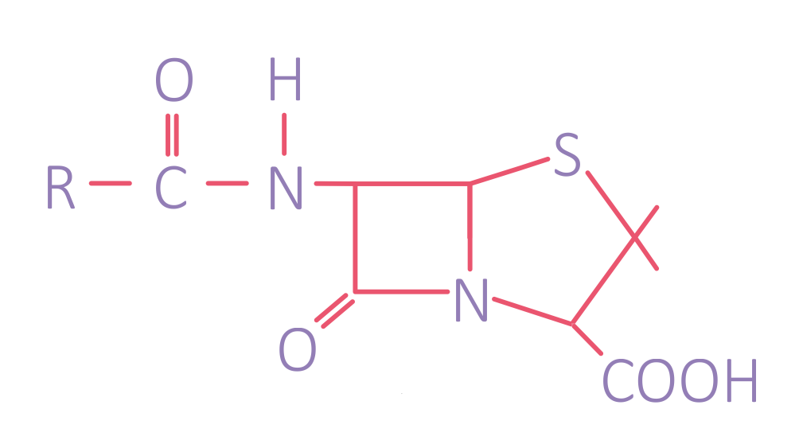
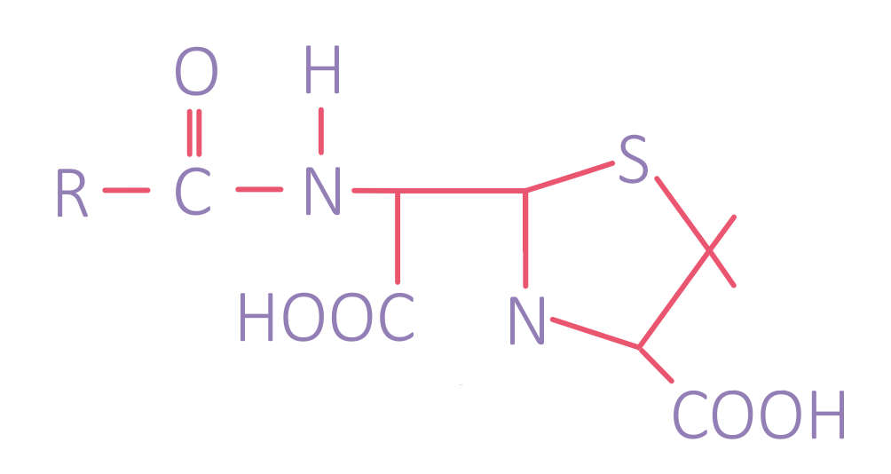
Beta-lactamases – Overview
Beta-lactamases are enzymes
produced by bacteria that
inactivate the beta-lactam
antibiotics by opening the ring
at the amide bond. (See figure)
Types of beta-lactamases:
ESBL (extended-spectrum b-lactamase): CTX-M (most frequently identified), SHV, TEM
Carbapenemases
AmpC-type cephalosporinases (limited epidemiological importance)
Intact antibiotic molecule
Enzyme opens lactam ring

Slide 10
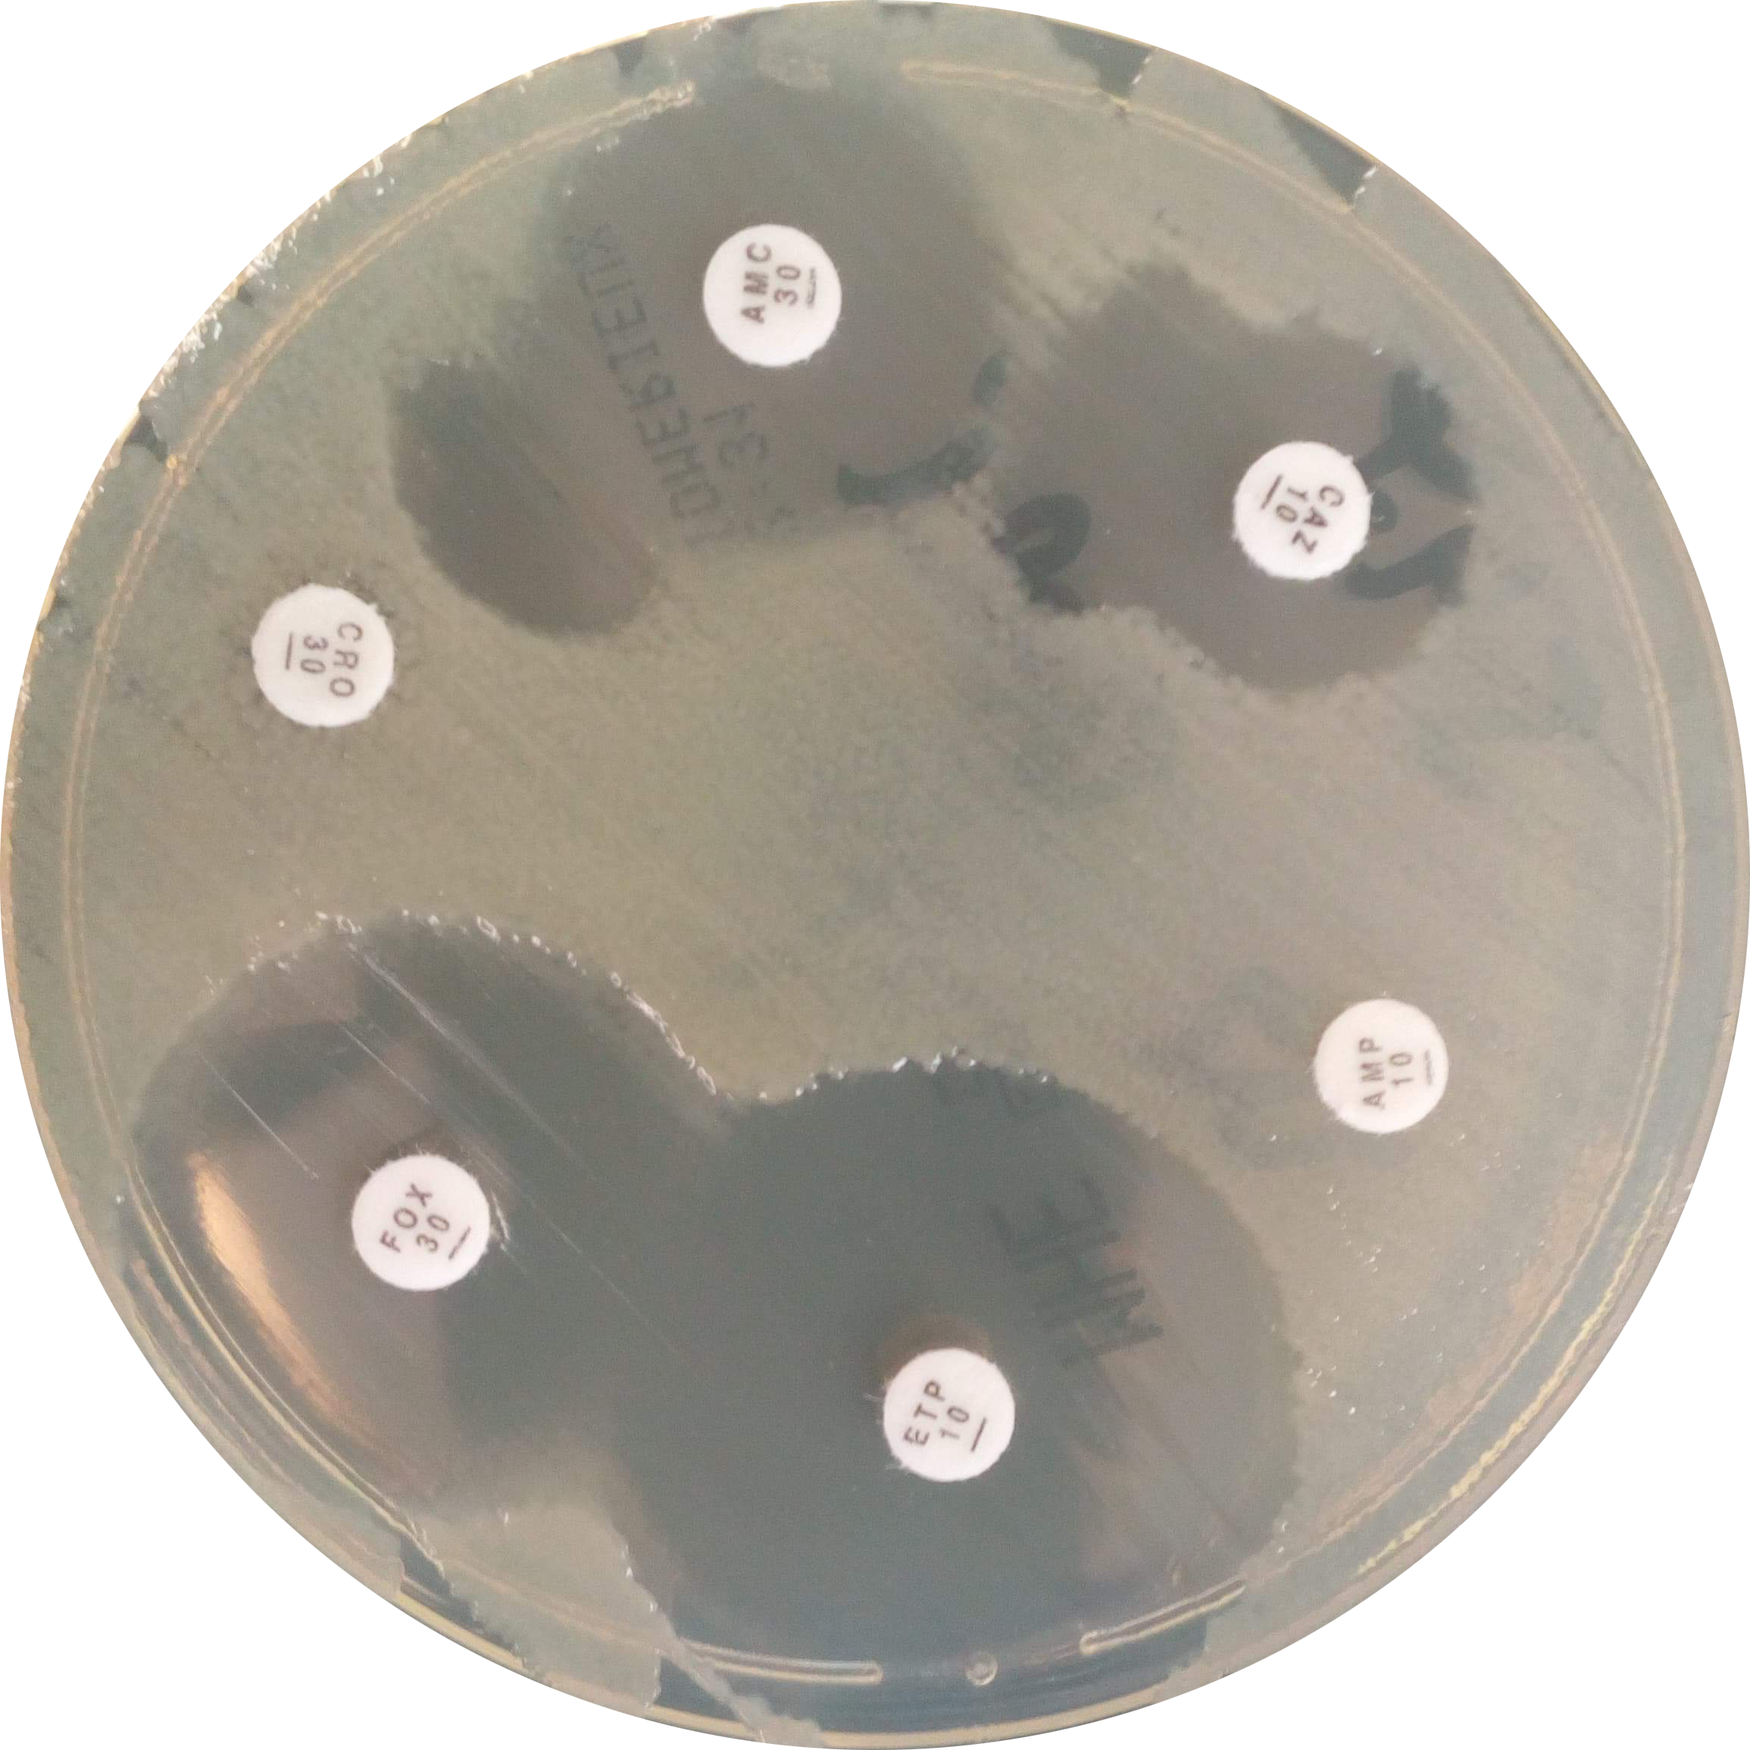
Explaining ESBL
ESBLs: beta-lactamases that hydrolyze most penicillins and cephalosporins, including oxyimino-beta-lactam compounds: 2nd, 3rd and 4th generation cephalosporins and aztreonam (not cephamycins and carbapenems)
ESBLs: are inhibited by beta-lactamase inhibitors (clavulanic acid, sulbactam, tazobactam) (EUCAST - 2017)
ESBL producing bacteria

Slide 11
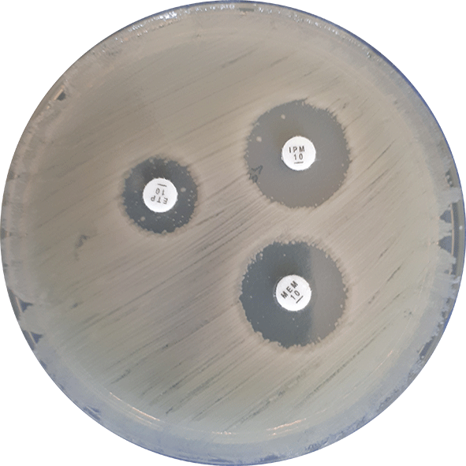
Carbapenems
for example: imipenem, meropenem, ertapenem and doripenem
have the broadest spectrum of activity
used in severe infections / as last-line agents (the treatment of infection caused by ESBL-producing bacteria)
Carbapenem resistant Gram-negative bacteria

Slide 12
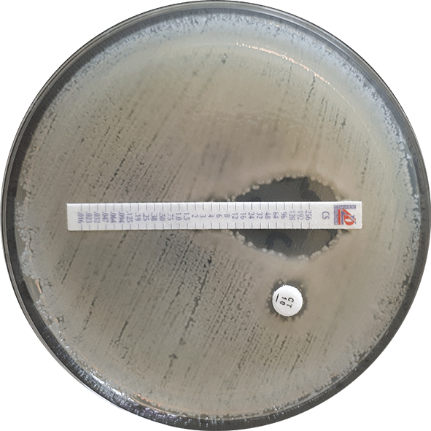
Carbapenemases
are beta-lactamases that hydrolyze penicillins, in most cases cephalosporins and to various degrees carbapenems and monobactams (EUCAST)
types: OXA, KPC, NDM, IMP, VIM, etc.
OXA and KPC-producing bacteria infections can be treated with the combination of meropenem and beta-lactamase inhibitor
E-test for carbapenemase

Slide 13
The current state of resistance and detection - 1
Higher risk for infection with resistant bacteria due to contact with colonized persons or contaminated devices:
extended hospital stay
stay in intensive care unit
exposure to broad-spectrum antibiotics

Slide 14
The current state of resistance and detection - 2
Resistance is increasing rapidly worldwide (WHO, ECDC data)
Colonization with ESBL-producing bacteria is becoming more common.
The most frequently encountered ESBL-producing species are E. coli and K. pneumoniae. (EUCAST - 2017)
International travels contribute to the spread of multiresistant bacteria.

Slide 15
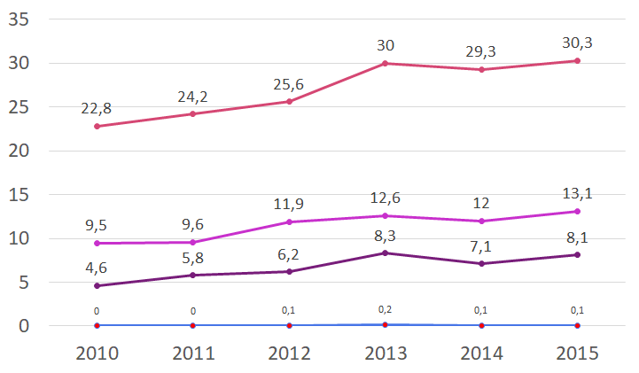
The current state of resistance and detection - 3
Reported percentage of bacteriae resistant to 3rd generation cephalosporins and carbapenems out of total invasive E. coli and K. pneumoniae isolates in European countries (based on ECDC data)
Percentage (%)
Year
3rd generation cephalosporin resistant E. coli
Carbapenem resistant E. coli
3rd generation cephalosporin resistant K. pneumoniae
Carbapenem resistant K. pneumoniae

Slide 16
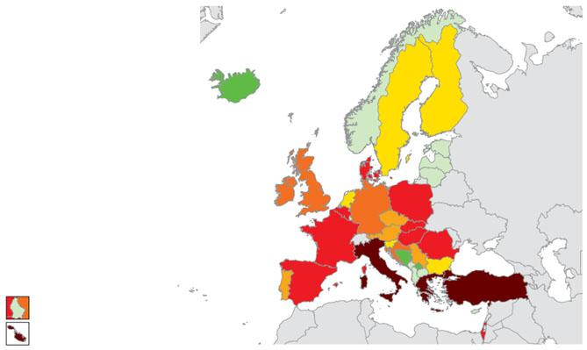
The current state of resistance and detection - 4
Occurrence of carbapenemase-producing Enterobacteriaceae
(K. pneumoniae and E. coli)
Information from hospitals of 38 European countries, May 2015
Epidemiological stages, 2014-2015
Countries not participating
No case reported (Stage 0)
Sporadic occurence (Stage 1)
Single hospital outbreak (Stage 2a)
Sporadic hospital outbreaks (Stage 2b)
Regional spread (Stage 3)
Inter-regional spread (Stage 4)
Endemic situation (Stage 5)
Luxembourg
Malta
Source: Carbapenem-resistant Enterobacteriaceae (CRE), 8 April 2016, Stockholm: ECDC; 2016

Slide 17
The current state of resistance and detection - 5
The current methods for ESBL and carbapenemase detection:
isolated bacteria are usually a requirement
use of EUCAST principles: screening and confirmation tests: disk diffusion, Etest; combination disk test, MALDI-TOF MS, PCR techniques (and Carba NP tests for carbapenemases)
the test is slow: 16+ hours
rapid detection is essential
to prevent further spread
to fight efficiently against MDR bacteria

Slide 18
The current state of resistance and detection - 6
The molecular methods, such as end-point PCR and real-time PCR can also be used targeting the main β-lactamases, with high specificity and sensitivity (and relative quickly, because not necessarily required isolated bacteria)
But the presence of the genes does not systematically imply enzymes production.
The LFIA (lateral flow immunoassay) test detects the produced enzymes.
This new innovation, an NG DetecTool (based on LFIA) detects the enzymes directly from patient’s sample.

Slide 19
This is the end of the
Theory of AMR Section
of the NG DetecTool training Thanks for watching!

